Slide 1

Heart Disease Prediction Using Machine Learning
An AI-Driven Approach for Early Diagnosis
zb
Presented by Y.S Raahil [222P1A3347] & Team

Slide 2

Introduction
33%
1 in 5
Global Deaths
Adults Affected
Heart disease caused 20.5M deaths in 2021
In developed countries
80%
Preventable
With early detection

Slide 3






Objectives
Enhance clinical decisions
Support early intervention
Identify key risk factors
For real-time assessment
Develop robust ML model
For accurate prediction
Our project aims to enhance diagnostic accuracy. We support early intervention strategies in clinical settings.

Slide 4





Approach
Data Collection & Preprocessing
Model Training & Evaluation
Gather and prepare patient data for analysis.
Apply algorithms and assess performance.
Feature Engineering & Selection
Deployment & Usability
Identify significant predictors of heart disease.
Develop user-friendly interface for predictions.

Slide 5
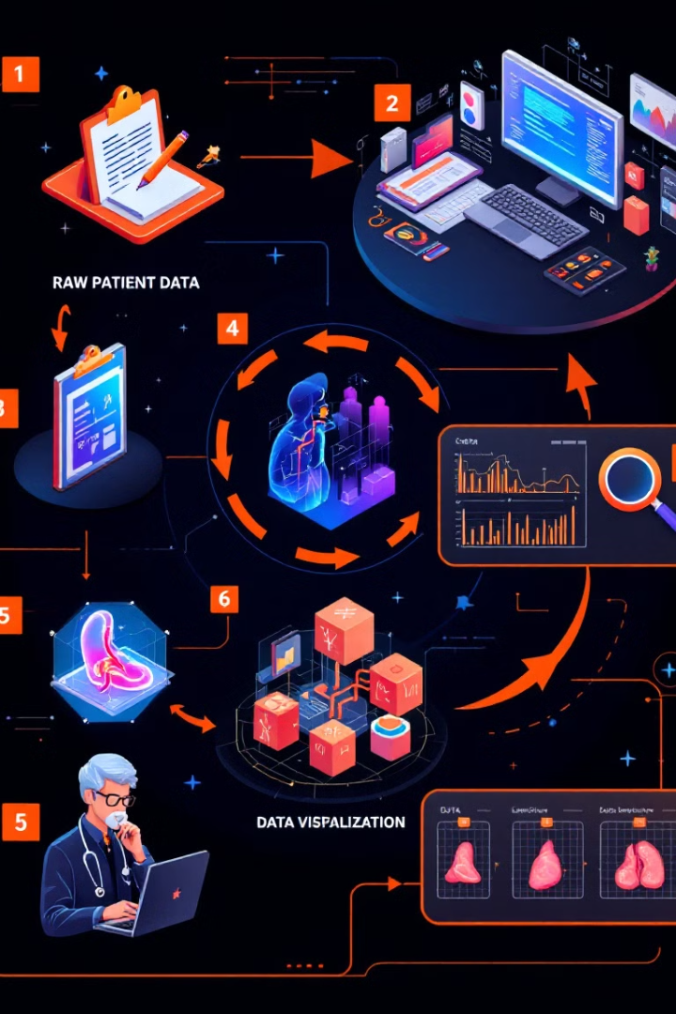




Data Processing Pipeline
Data Ingestion
Loading patient records
Preprocessing
Handling missing values
Model Training
Machine learning algorithms
Evaluation
Performance metrics assessment

Slide 6








Feature Selection
Correlation Analysis
Recursive Elimination
Understand relationships between variables
Remove less relevant features
Validation
Importance Ranking
Confirm optimal feature subset
Identify highest impact predictors

Slide 7
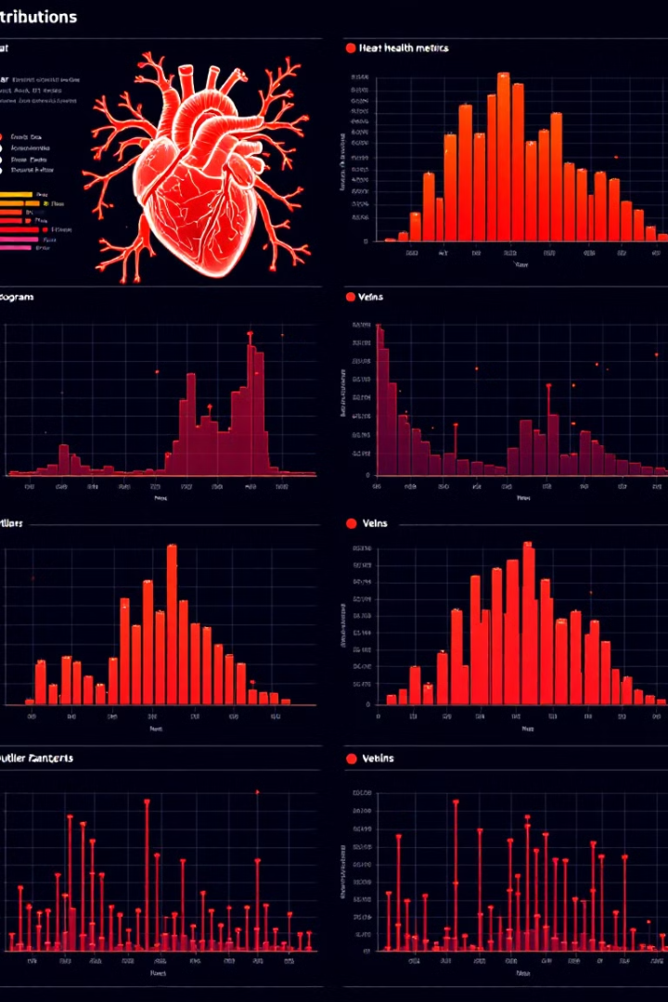
Feature Distribution & Outlier Detection
Distribution Analysis
Interquartile Range Method
We used histograms and density plots to visualize data distribution patterns. This revealed meaningful insights into age and blood pressure ranges.
Our IQR-based outlier detection identified anomalous values in cholesterol and heart rate measurements. This ensured data quality.
Statistical Validation
We applied rigorous statistical tests to verify data integrity. This confirmed our dataset was suitable for model training.

Slide 8
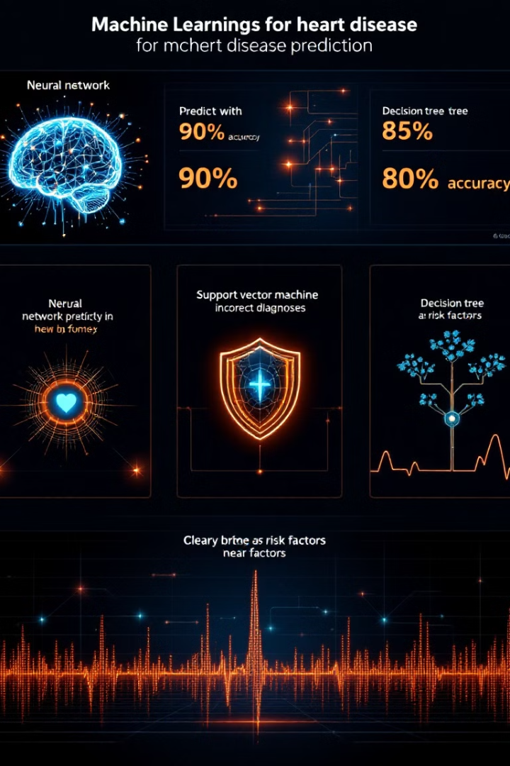



Machine Learning Models
Logistic Regression
Random Forest
Offers simplicity and clear interpretation of feature importance. Provides baseline performance with minimal complexity.
Handles complex non-linear relationships between variables. Robust against overfitting with strong ensemble properties.
XGBoost
Delivers superior performance through gradient boosting. Efficiently handles missing data and provides feature importance scores.

Slide 9
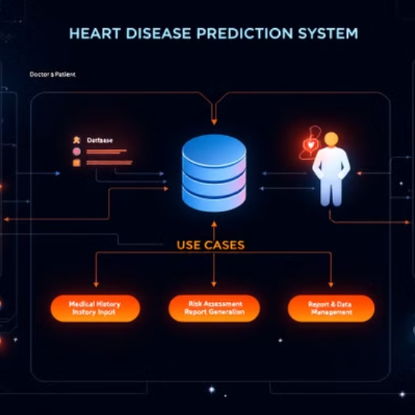
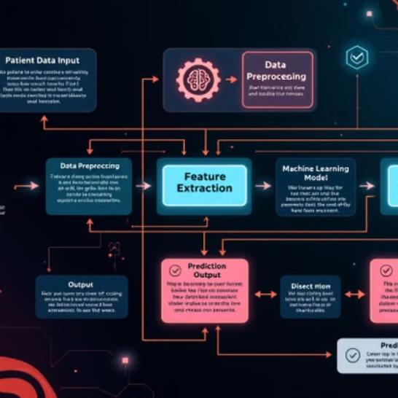
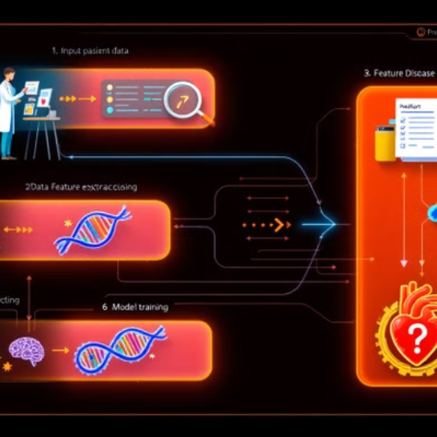
UML Diagrams

Slide 10
Model Evaluation
Accuracy
Measures the overall correctness of model predictions across all classes.
Precision & Recall
Precision assesses true positive ratio among positive predictions. Recall evaluates ability to identify all actual positive cases.
F1-Score
Provides a balanced measure between precision and recall, especially useful for imbalanced datasets.
ROC-AUC
Indicates model capability to distinguish between classes across various threshold settings.

Slide 11
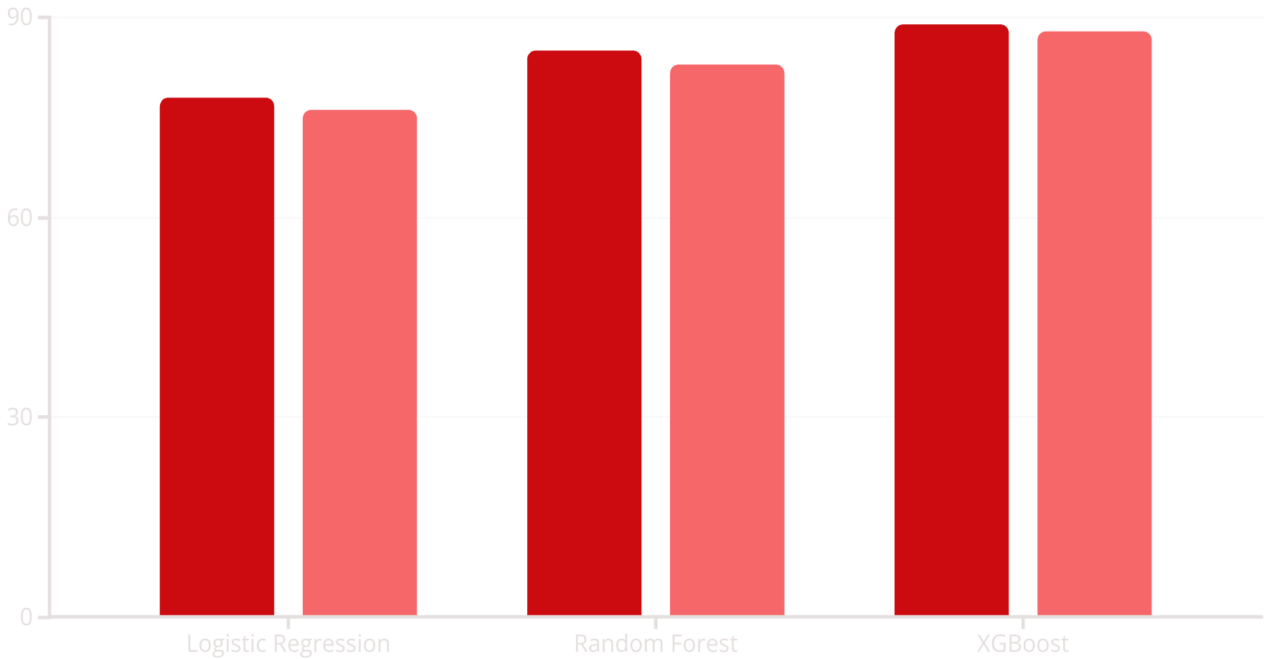
Model Evaluation Barplot
Accuracy
F1-Score
XGBoost consistently outperformed other models. Our evaluation focused on both accuracy and clinical relevance.

Slide 12





Future Enhancements
Additional Health Factors
Genetic history, stress levels
Deep Learning Models
Neural networks for complex patterns
Web/Mobile Application
Wider accessibility for healthcare
Healthcare Integration
EMR systems compatibility

Slide 13



Conclusion
Early Detection Impact
Could save millions of lives annually
Clinical Decision Support
Empowers healthcare professionals
Future Development
Integration with wearable health devices

